Slide 1


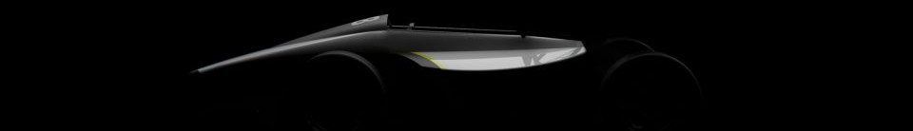

REACTION TIME
1
5
SCORE
SCORE
568
399
MILISECONDS
MILISECONDS
{{{
WINNER

Slide 2
REACTION TIME
SCORE
SCORE
568
399
MILISECONDS
MILISECONDS
{{{
{{{

